Slide 1

Benson Nyota/Datumlytics

Slide 2



INTRODUCTION TO MACHINE LEARNING
Machine learning is a subset of artificial intelligence that focuses on teaching computers to
learn from data and improve over time without explicit programming.
Supervised Learning
Un-Supervised Learning
Reinforcement Learning
Benson Nyota/Datumlytics

Slide 3
Use Cases:
Fraud Detection
Financial firms
Natural Language Processing
Autonomous Systems
Healthcare
Image and Speech recognition
Recommender System
Benson Nyota/Datumlytics

Slide 4
DATA SCIENCE FRAMEWORK FOR MACHINE LEARNING
Problem Definition
Data Collection and Preparation
Exploratory Data Analysis
Model Selection and Training
Model Validation and Tuning
Model Testing & Evaluation
Problem Definition
Feature Selection & Engineering
Data Splitting
Model Selection and Training
Model Deployment
Model Monitoring & Maintanance
Benson Nyota/Datumlytics

Slide 5
PROBLEM DEFINITION
Classification
Clustering
Regression
Dimensionality reduction
Time series
Reinforcement tasks
Benson Nyota/Datumlytics

Slide 6
Objectives:
Clearly outline the problem you aim to solve and the desired outcome.
Specify the scope and limitations of the project.
Identify stakeholders and their requirements.
Establish a timeline for the project, including milestones and deliverables.
Determine the resources needed, such as data, tools, and team members.
Evaluation Metrics:
Regression metrics: Mean Absolute Error (MAE), Mean Squared Error (MSE), Root Mean Squared Error (RMSE), R-squared, etc.
Classification metrics: Accuracy, Precision, Recall, F1-score, Area Under the Receiver Operating Characteristic (ROC) Curve (AUC-ROC), etc.
Clustering metrics: Silhouette score.
Benson Nyota/Datumlytics

Slide 7
DATA COLLECTION AND PREPARATION
Data Sources
Databases, APIs, Web Scraping, Open Data Repositories, Surveys
Data Cleaning
- Missing values
Data Preprocessing
-Scaling
-Transformation
- Inconsistencies
Benson Nyota/Datumlytics

Slide 8
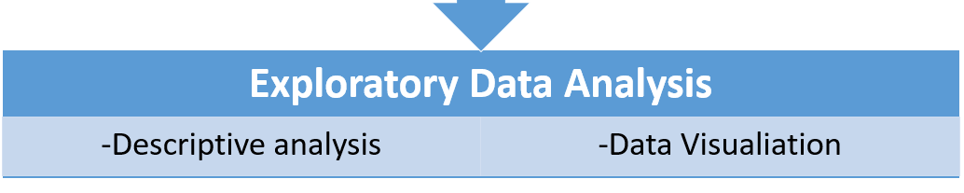
Feature Selection and Engineering
Feature importance and Selection methods
Feature Engineering Techniques
Dimensionality Reduction
Benson Nyota/Datumlytics

Slide 9

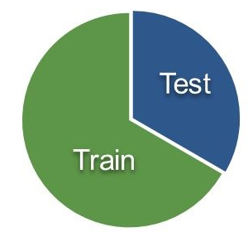
Data Splitting
Train Test Split
Cross validation
The training set is used to train the machine learning model, while the testing set is used to evaluate the model's performance on unseen data.
A more robust method for assessing model performance that reduces the risk of overfitting and provides a better estimate of the model's generalization ability.
Benson Nyota/Datumlytics

Slide 10
MODELLING
Linear Regression
Logistics regression
Decision Trees
Random Forest
SVM
Neural network
This is training an algorithm using the prepared data
to learn the insights and patterns.
Benson Nyota/Datumlytics

Slide 11
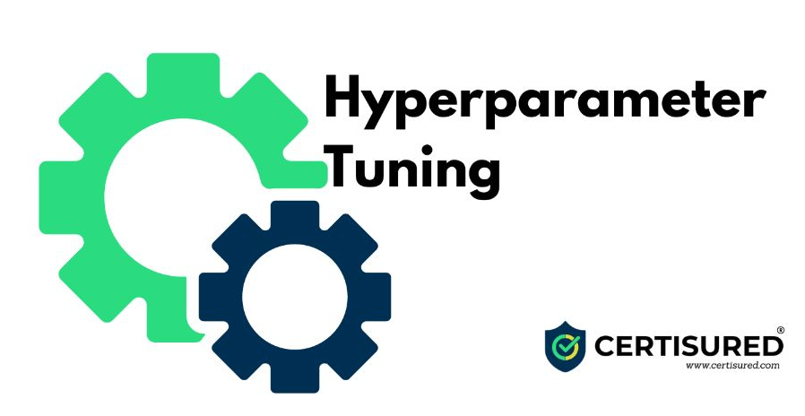
Model Training Best Practices
Feature scaling
Regularization
Early stopping
Early stopping
Data Augmentation
Model ensembling
Benson Nyota/Datumlytics

Slide 12
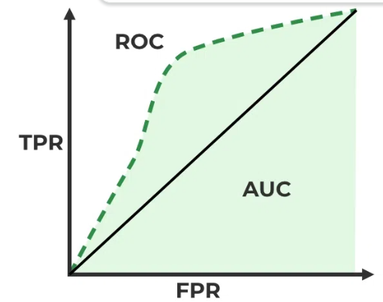
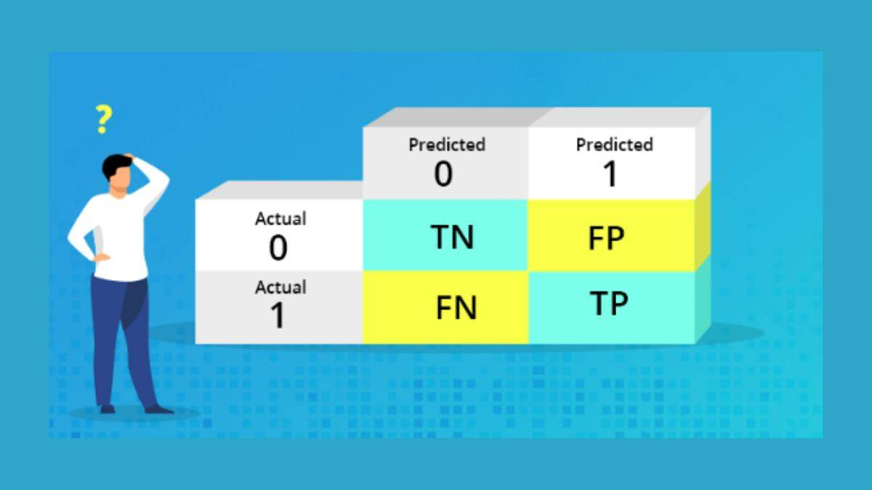
Model Validation and Tuning
1.1 Performance Evaluation
Confusion Matrix
ROC & AUC
Benson Nyota/Datumlytics

Slide 13
2.1 Model Tuning Techniques:
Regularization
Lasso
Ridge
Elastic Net
Ensemble Methods
Bagging
Boosting
stacking
Hyperparameter Tuning
Grid search
Random search
Bayesian optimization
Benson Nyota/Datumlytics

Slide 14
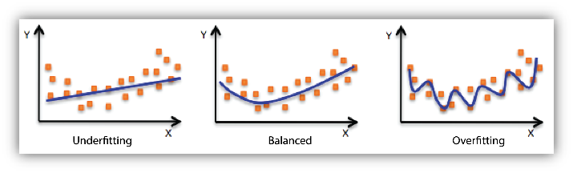
Overfitting & Overfitting
When a model fails to capture the underlying structure of the data and performs poorly on both training and testing sets
When a model captures noise in the training data and performs poorly on unseen data
Benson Nyota/Datumlytics

Slide 15
Model Testing and Evaluation
Model Deployment
Model Monitoring & Maintenance
Benson Nyota/Datumlytics

